Slide 1
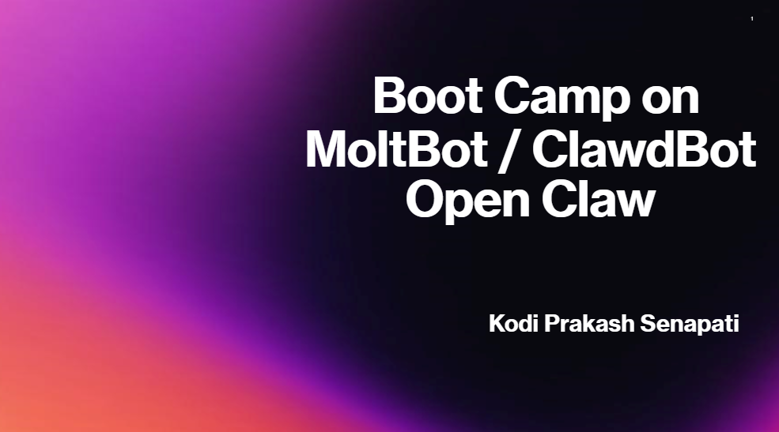

Slide 2
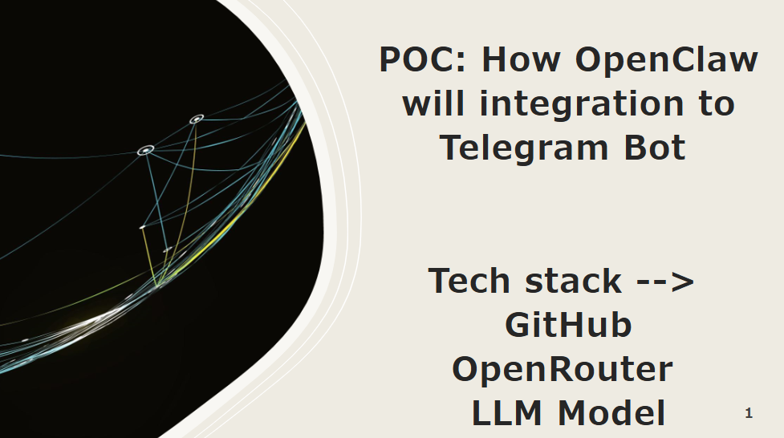

Slide 3
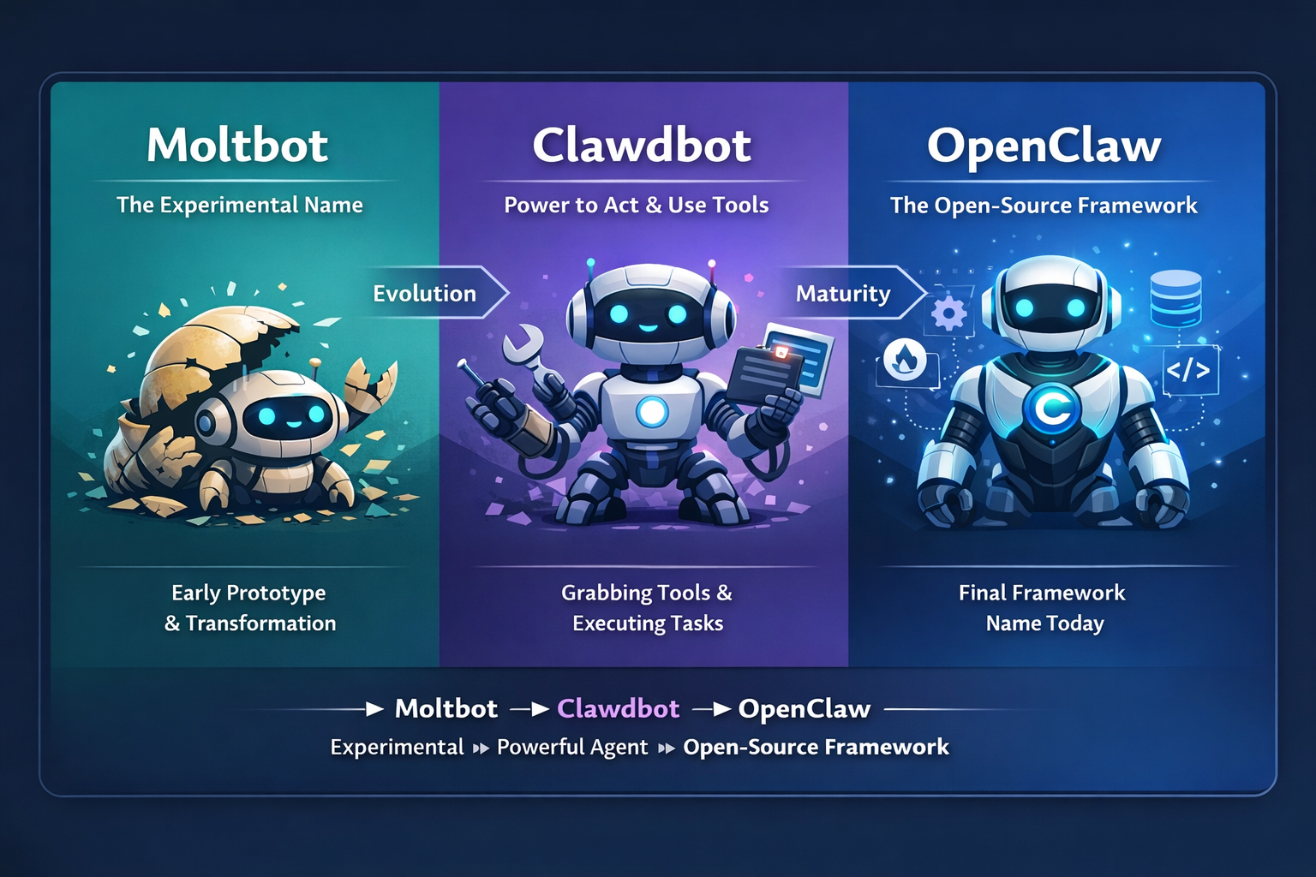
Moltbot was the experimental or Research name. Clawdbot showed the power to act and use tools. OpenClaw is the final open-source AI Agent framework

Slide 4
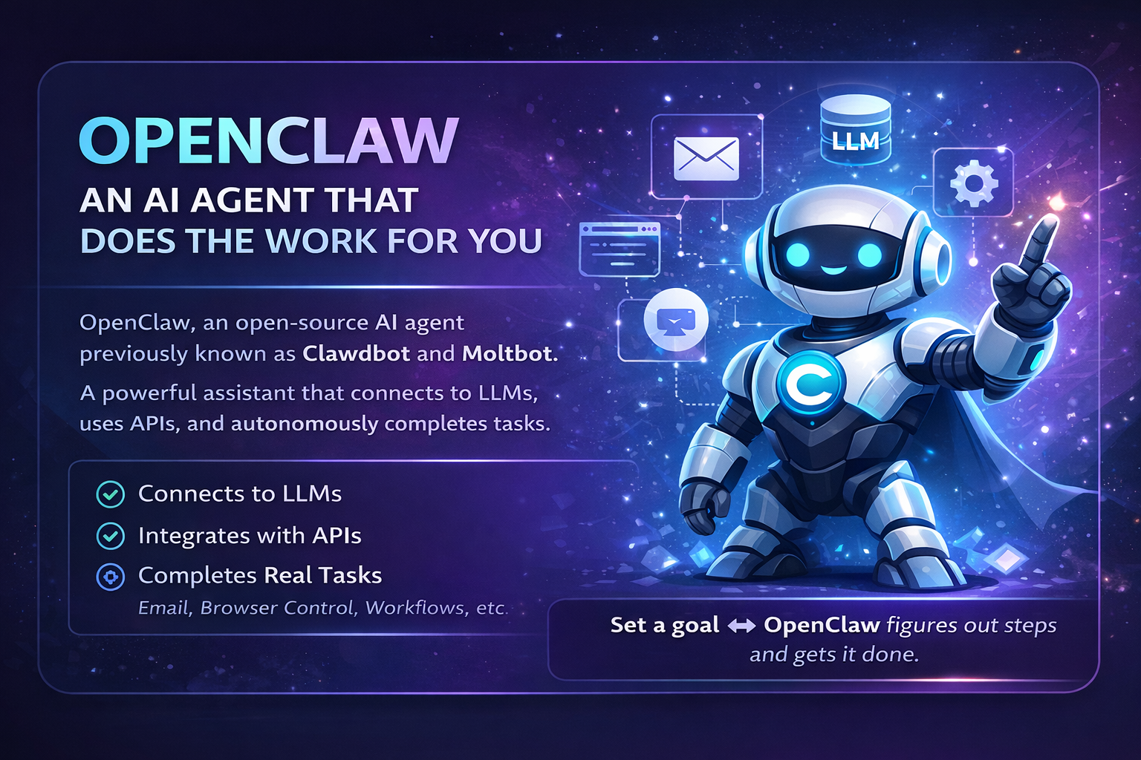
What is Open Claw?

Slide 5
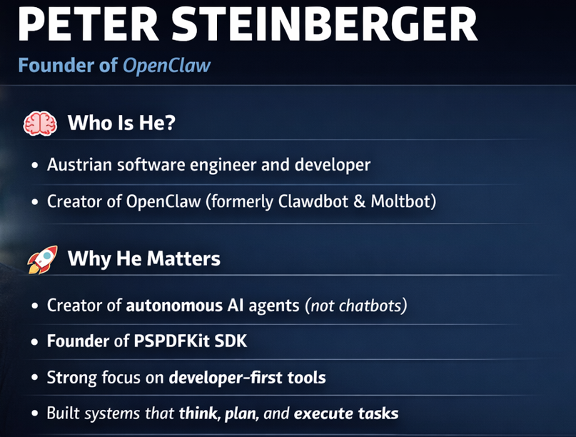
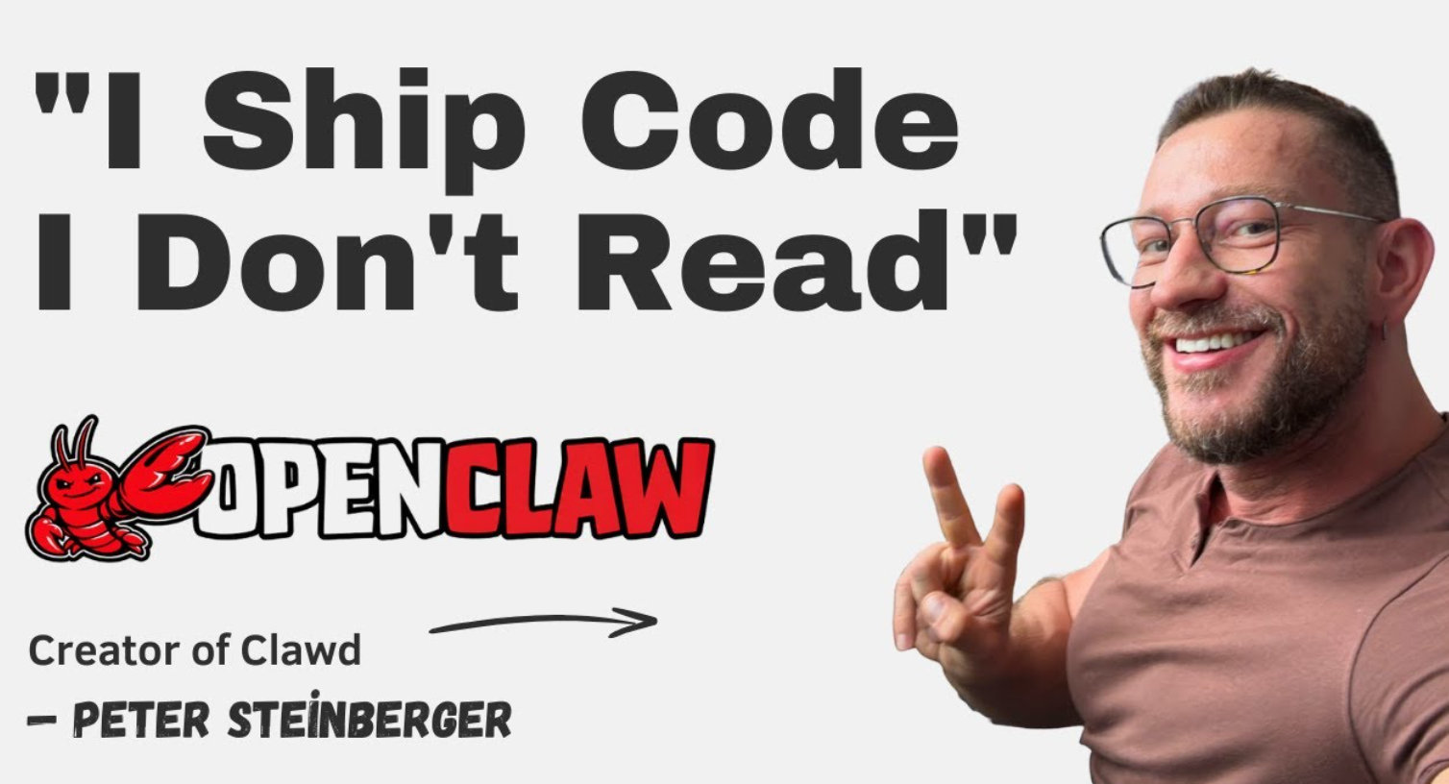
Creator of Open Claw
https://github.com/kodigitaccount/Moltbot_Clawdbot_Openclaw

Slide 6
What Projects Can You Build with Open Claw?
✅ Ideal Project Types
Real-time AI Assistants Telegram / WhatsApp bots, internal helpdesk, dev assistants
Workflow Automation Agents Resume screening, invoice processing, email & CRM automation
DevOps & Engineering Agents CI/CD helpers, log analysis, cloud cost optimization
Data & Analytics Agents Auto-EDA, SQL agents, report generation
Monitoring & Watchdog Agents Uptime checks, alerts, price & security monitoring
Multi-Agent Systems Planner–executor, researcher–writer pipelines
Internal Enterprise AI Tools (best practice) HR, finance, policy, knowledge-base assistants
❌ Not Ideal For
Ultra-low latency systems • Live audio/video • Unrestricted crawling

Slide 7
Agentic AI Workshop ➔
https://www.youtube.com/playlist?list=PLVlQHNRLflP8Pt3wVlRWRaXZXi79cIwSq
Thank you Team

